Slide 1
Baseball Udacity Attempt 2
File created on: 8/23/2021 6:55:41 PM

Slide 2
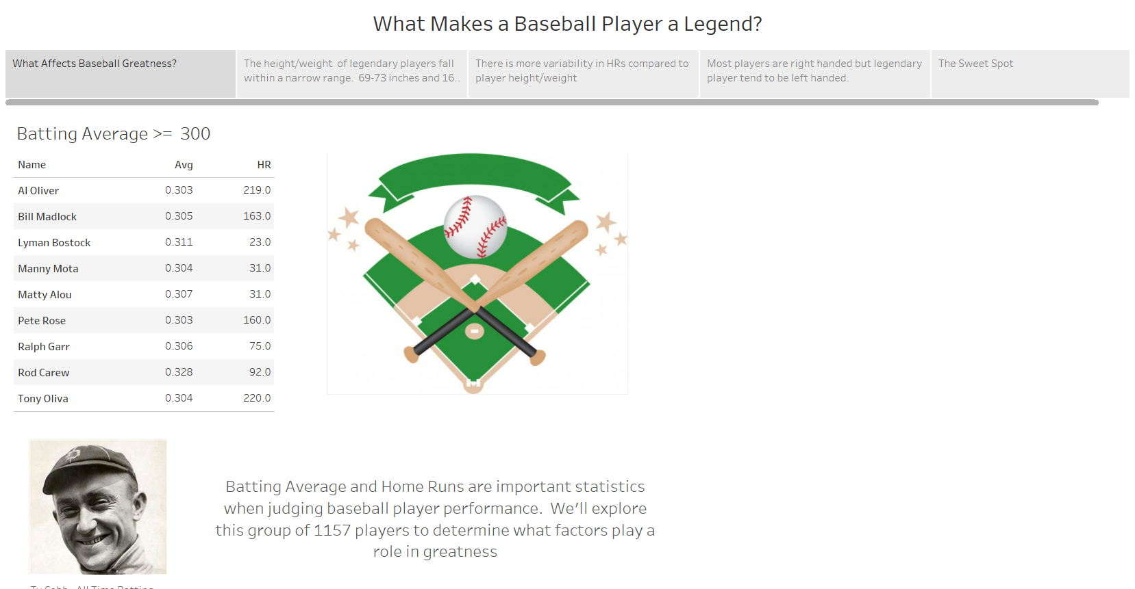

Slide 3
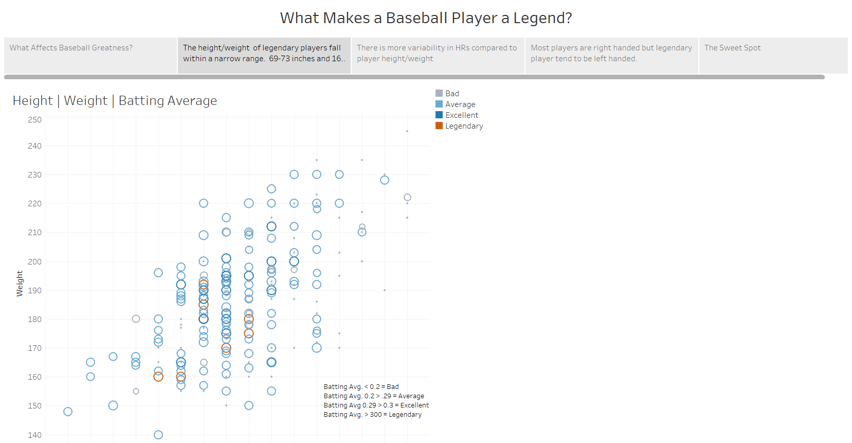

Slide 4
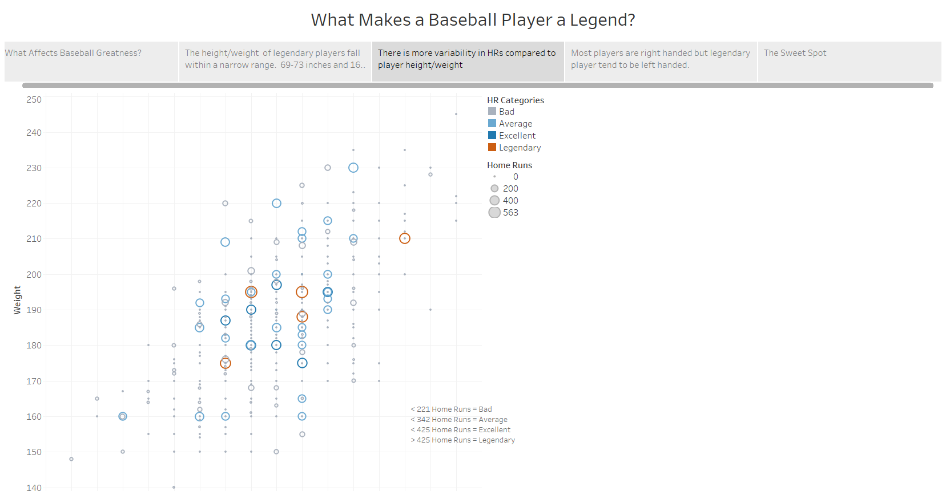

Slide 5
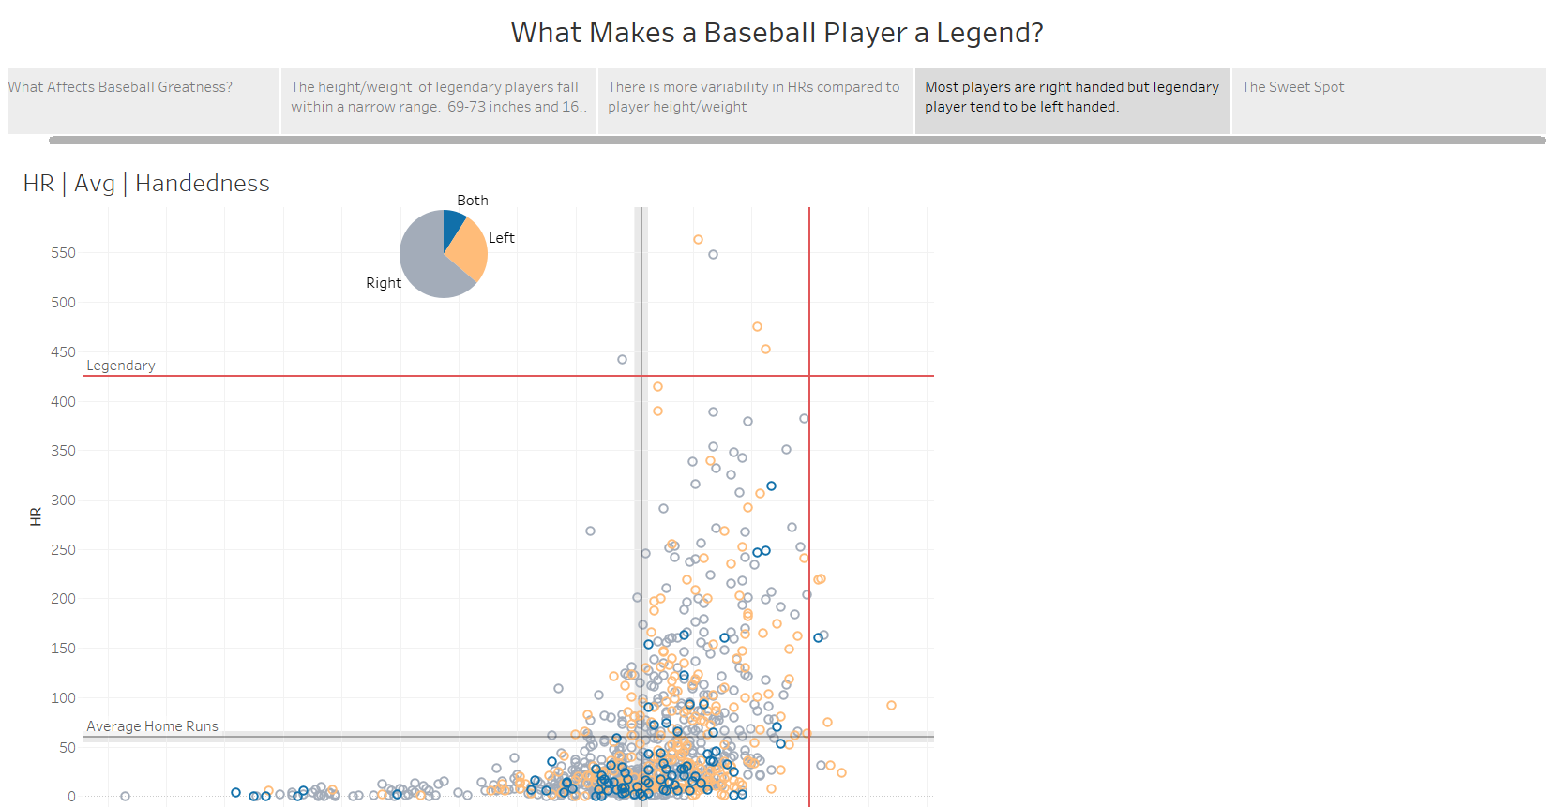

Slide 6
